Slide 1

ANALYSIS AND PREDICTION OF AIRLINE PASSENGER SATISFACTION USING PYSPARK
By:
Yaswanth Varma Sagiraju

Slide 2

Introduction
Aim:
To analyze and predict passenger satisfaction based on flight experience features.
Develop a machine learning model to predict satisfaction and deploy it via Streamlit for real-time predictions.
Data Description:
The "Airline Passenger Satisfaction" dataset from Kaggle includes both numerical and categorical data, providing a wide range of information on passenger experiences.
It covers key aspects of the flight experience such as inflight services, seat comfort, cleanliness, and departure/arrival times, offering a comprehensive view of passenger preferences.
This dataset facilitates thorough analysis and predictive modeling to understand the factors that influence passenger satisfaction, making it valuable for airlines and researchers alike.

Slide 3
Data Preparation
Initial Exploration: Conducted preliminary exploration to understand the structure, features, and characteristics of the dataset.
Data Cleaning: Performed initial data cleaning tasks, including handling missing values, removing duplicates, and addressing inconsistencies, to ensure the dataset's quality and readiness for further analysis.

Slide 4
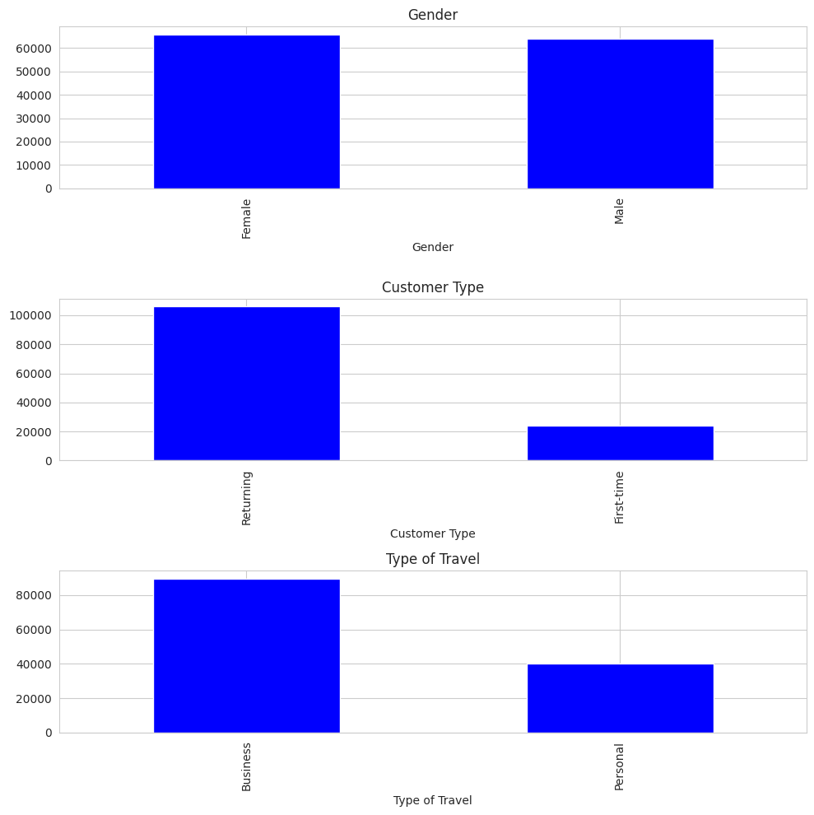
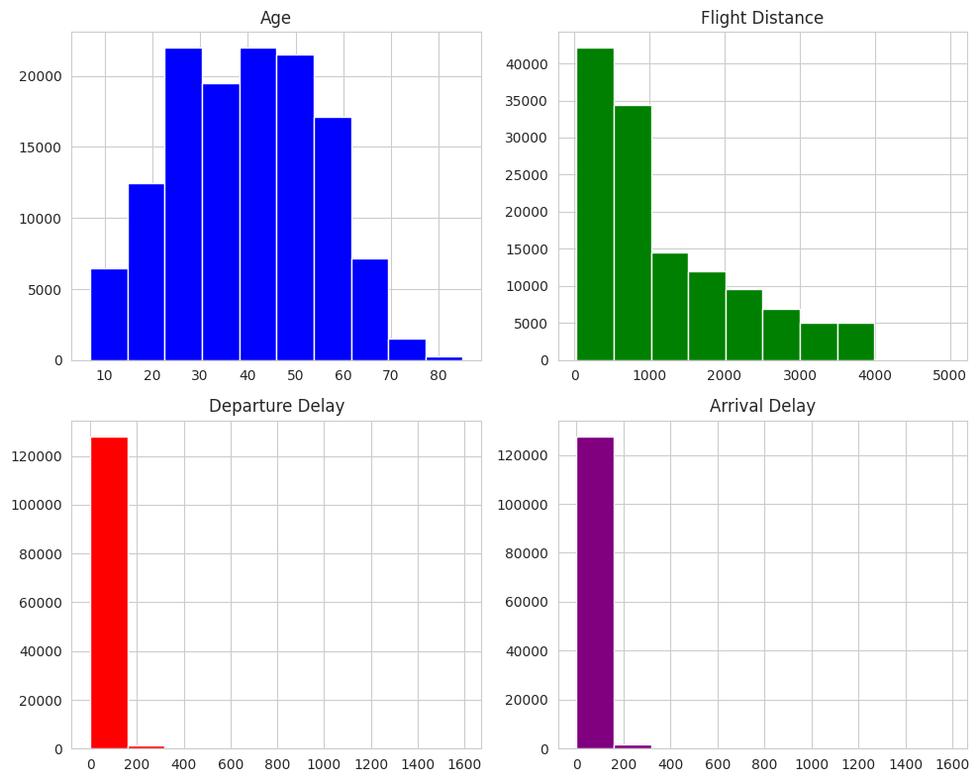
Exploratory Data Analysis

Slide 5
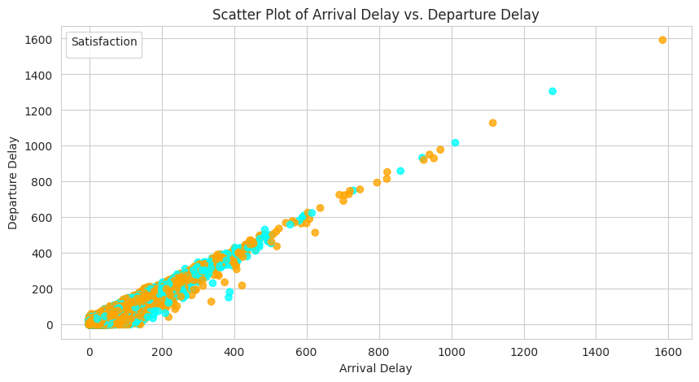
Contd..
What is the level of airline passenger satisfaction based on Departure Delay and Arrival Delay?

Slide 6
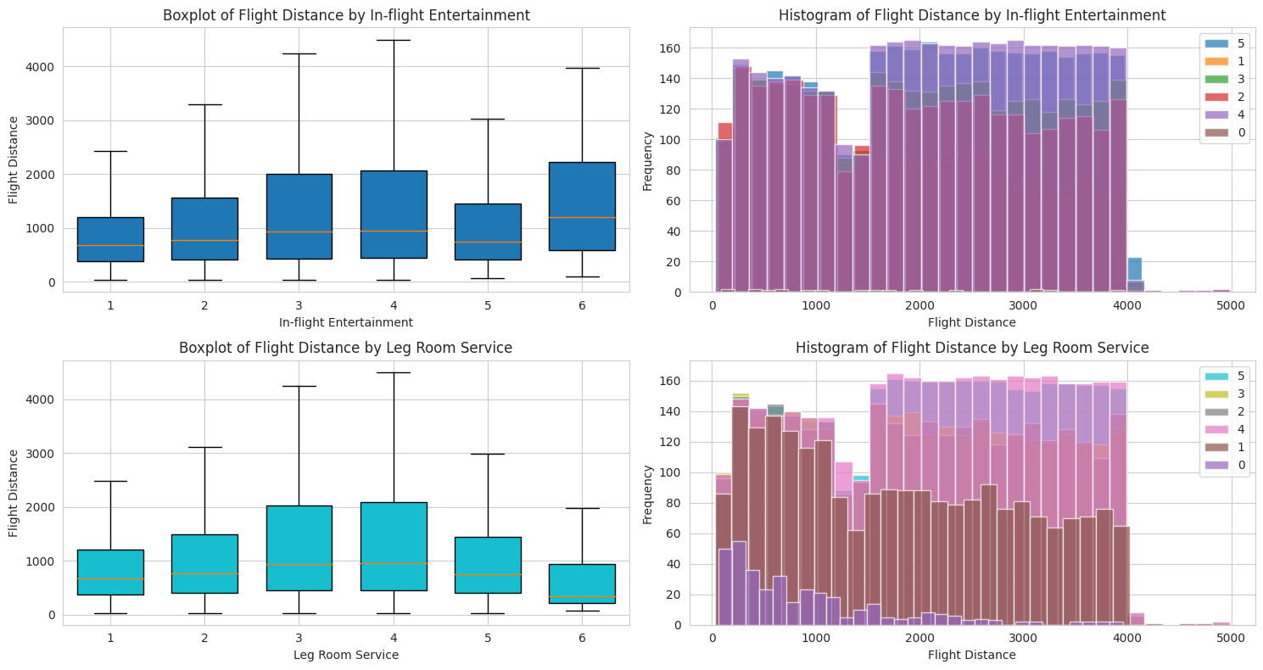
Contd..
What is the level of airline passenger satisfaction when viewed based on Flight Distance?

Slide 7
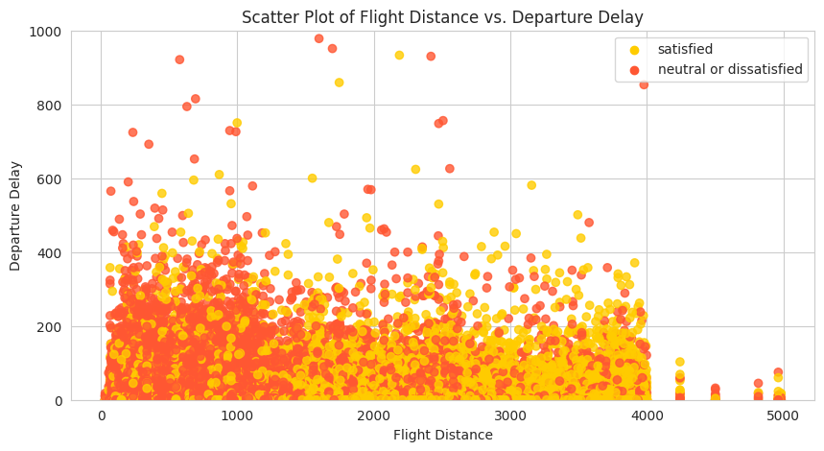
Contd..
What is the level of airline passenger satisfaction when viewed based on Flight Distance and Departure Delay?

Slide 8
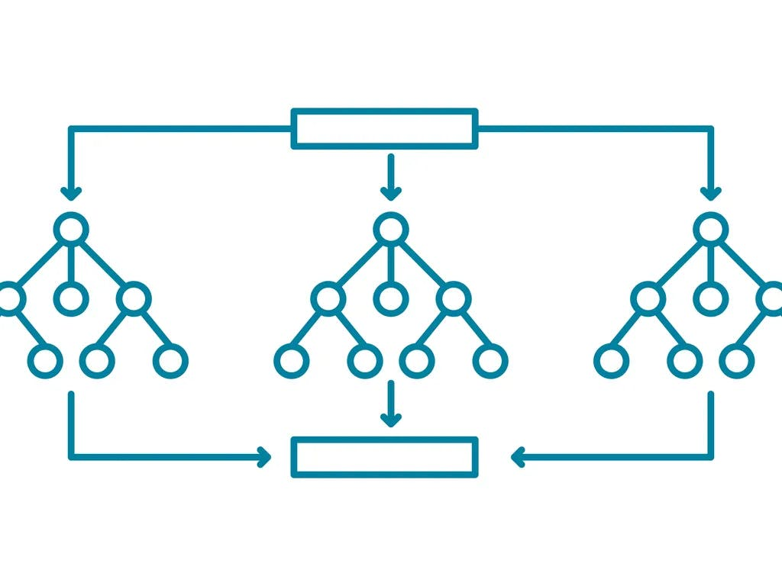
Machine Learning Modelling
Random Forest Classifier
Combines multiple decision trees for better predictions, handling both numerical and categorical data effectively.
Offers high accuracy, robustness against overfitting, and interpretable feature importance rankings.
Achieved an accuracy of 92.36%, indicating strong predictive performance.
Precision, recall, and F1 score also demonstrate high values, reflecting reliable model performance.

Slide 9
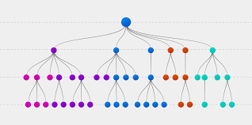
Decision Tree Classifier
Simple yet powerful classification algorithm, suitable for interpretation and understanding.
Efficiently handles both numerical and categorical data.
Achieved a respectable accuracy of 87.04%, indicating good predictive performance.
Precision, recall, and F1 score also demonstrate strong values, reflecting reliable model performance.

Slide 10
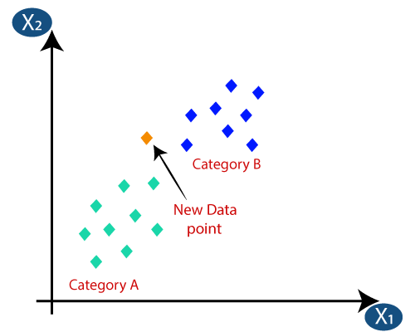
KNN Classifier
Utilizes a simple yet effective algorithm based on nearest neighbors for classification tasks.
Suitable for datasets with complex decision boundaries and non-linear relationships.
Achieved a commendable accuracy of 91.41%, indicating strong predictive performance.
Precision, recall, and F1 score also demonstrate robust values, reflecting reliable model performance.

Slide 11
Results Comparison
Model | Accuracy | Precision | Recall | F1 Score
Random Forest | 0.9236 | 0.9235 | 0.9236 | 0.9236
Decision Tree | 0.8704 | 0.8706 | 0.8704 | 0.8698
KNN | 0.9140 | 0.9143 | 0.9140 | 0.9137

Slide 12
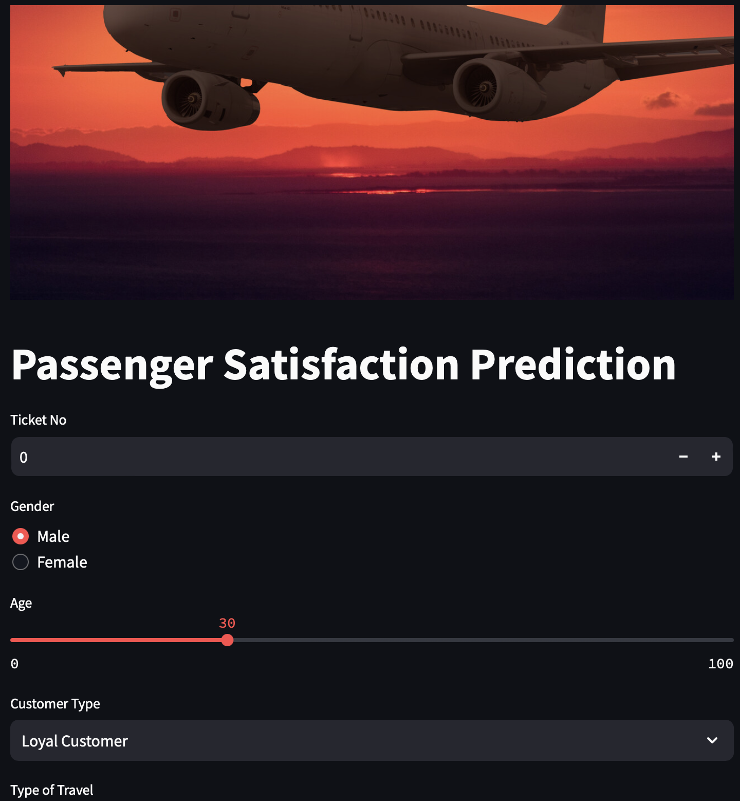
Streamlit Application

